Slide 1


PSM1 Presentation by: Adib Bin Morshed Matric No.: A20EC4008

Slide 2
Overview
Introduction
Literature Review
Methodology Project
Requirements and analysis Design
Conclusion

Slide 3


Problem Statement
Keeping track of all the publications from each faculty member can be a challenging task, particularly when this information is dispersed over numerous websites and databases.
It can be challenging to obtain an accurate picture of the faculty's research output because of discrepancies in data and inaccuracies caused by manual reliance on individual faculty members.
Faculty members may miss out on on funding or partnership opportunities as well as possible avenues for research advancement without a thorough and current perspective of research output.

Slide 4
Project Aim
The purpose of this project is to develop a web-based dashboard system that’ll highlight publications including the indexed publications, non-indexed publications, and citations to improve the decision-making process and can assist faculty members with keeping track of faculty publications, identifying patterns in research output, and automating the process of updating publication data by giving them a thorough and current perspective of research output.

Slide 5
Project Objectives
To gather and analyse data on the publication output of faculty members in the Faculty of Computing at UTM.
To enable the faculty to identify research strengths and areas for improvement within the department.
To support accreditation and performance evaluations by providing reliable and up-to-date data on faculty publication output.
To provide a comprehensive and user-friendly platform for tracking and analyzing publication output within the Faculty of Computing at UTM, with the goal of improving research outcomes and informing decision-making.

Slide 6
Project Scope
Web scraping data from various sources including the UTM website, Google Scholar, and other academic databases.
Creating a dashboard that allows users to view and analyze publication data based on various criteria such as publication year, journal, and citation count.
The project will use appropriate web scraping and data visualization tools based on the requirements and constraints of the project.

Slide 7
Technology Used
FrontEnd | BackEnd
React.js | Django,MongoDB
React.js: A popular JavaScript library for building user interfaces
Django: A popular Python web-framework for backend

Slide 8


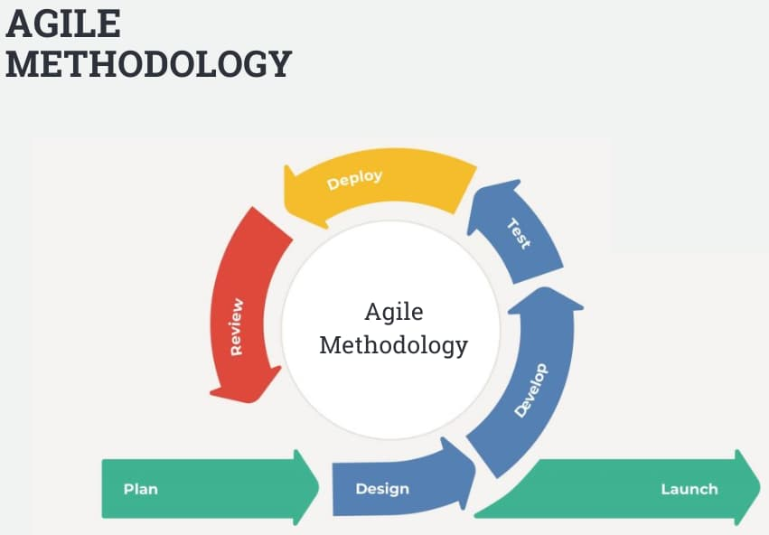
Agile Methodology

Slide 9
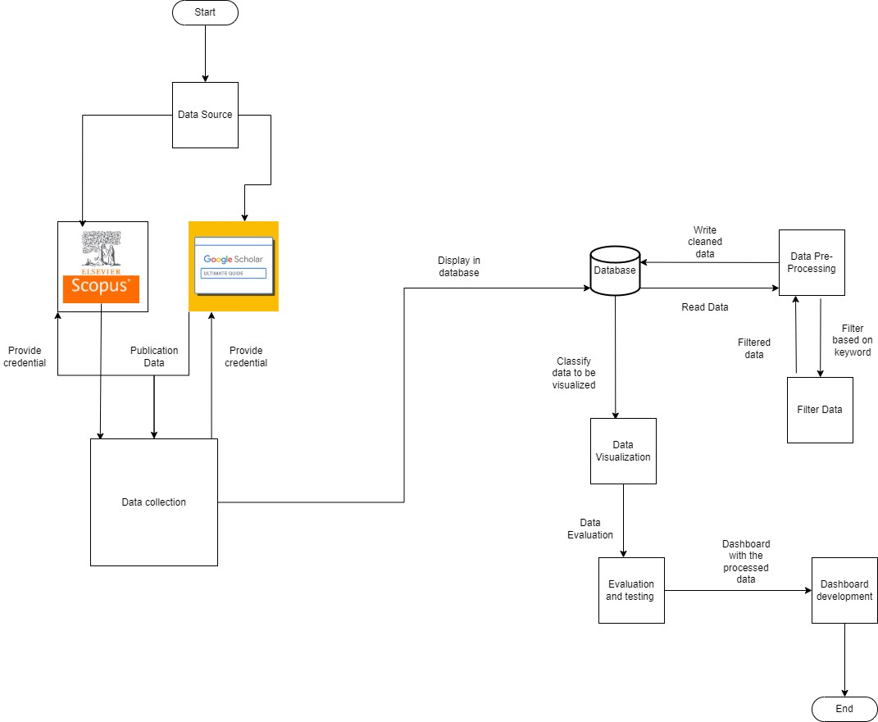
Implementation

Slide 10
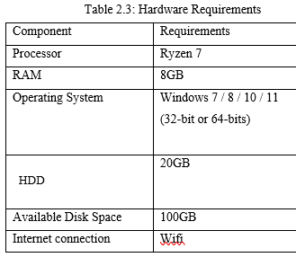
Hardware Requirements

Slide 11
Software Requirements
Description | Software
IDE | VS Code
Documentation | Ms Word
Coding Application | Python, JavaScript
Database | MongoDB

Slide 12
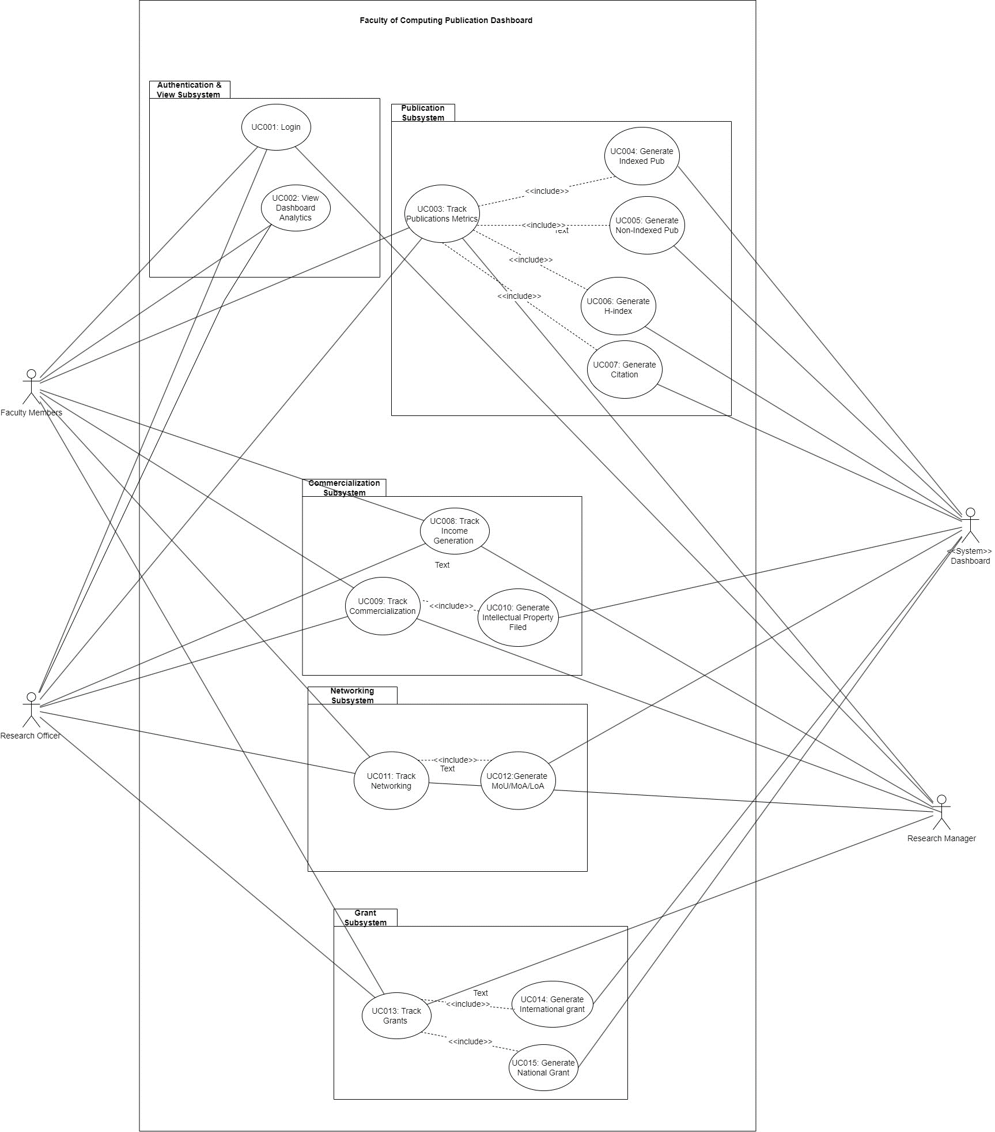
Use Case

Slide 13
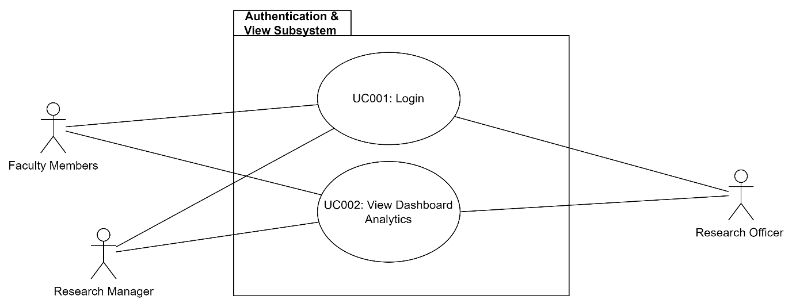
Subsystems

Slide 14
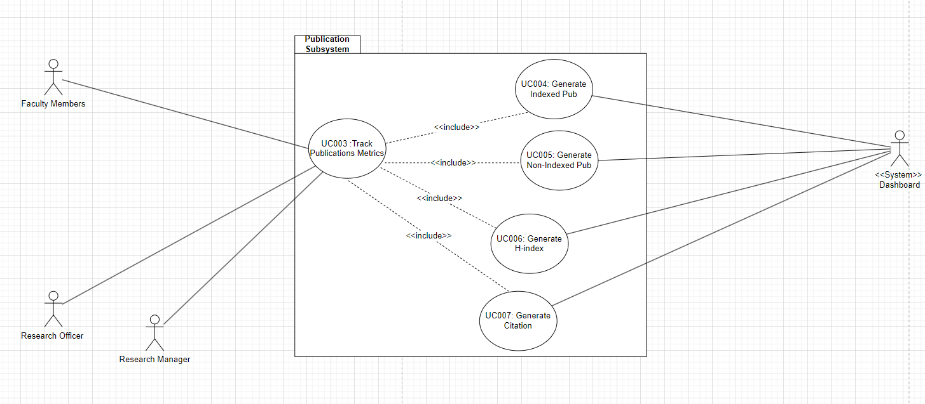
Subsystems

Slide 15
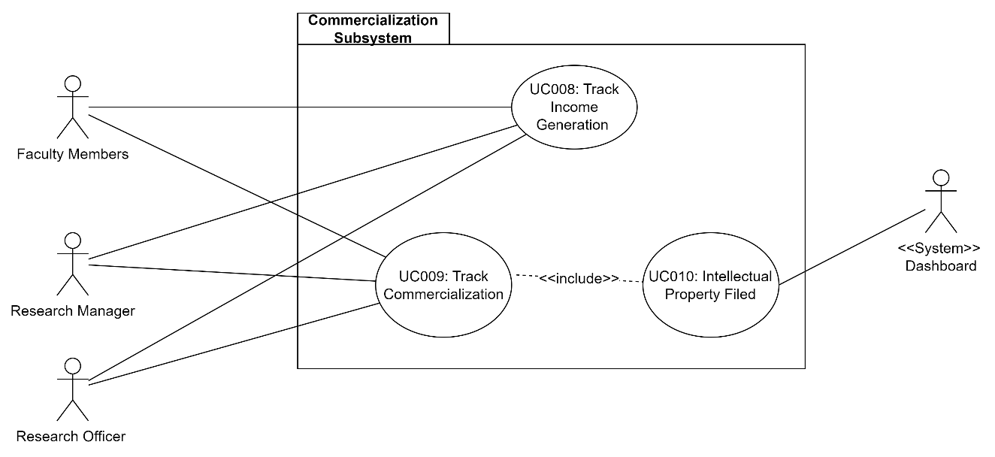
Subsystems

Slide 16
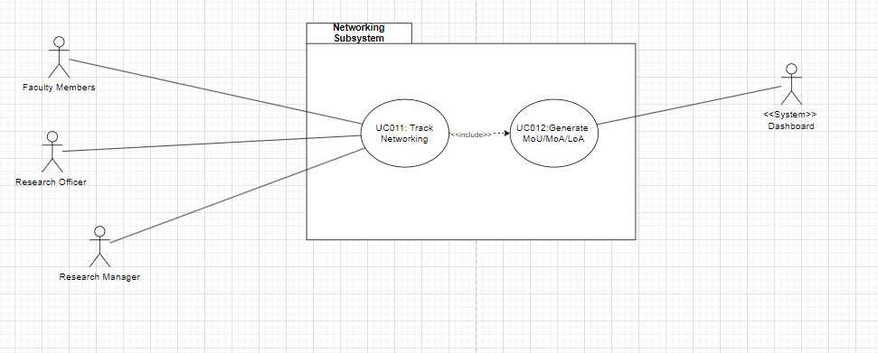
Subsystems

Slide 17
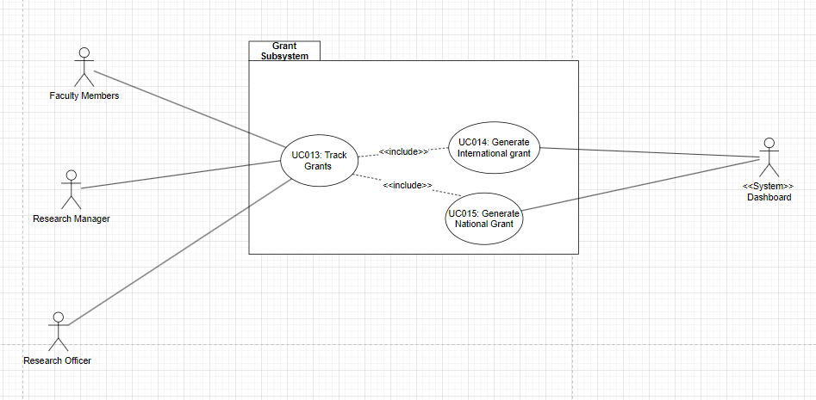
Subsystems

Slide 18
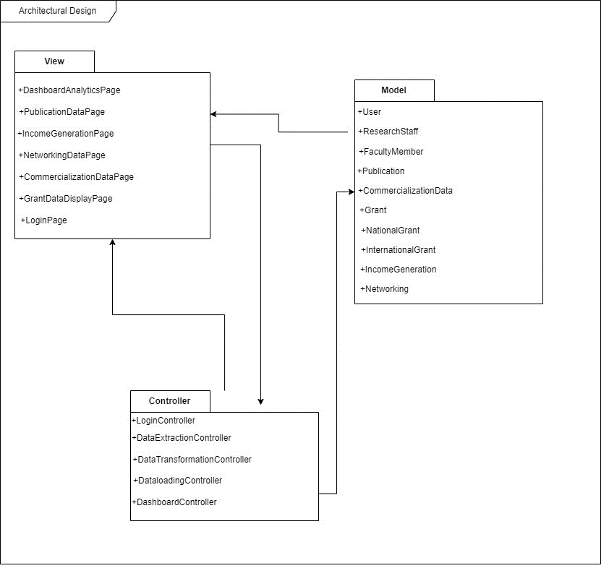
System Architecture

Slide 19
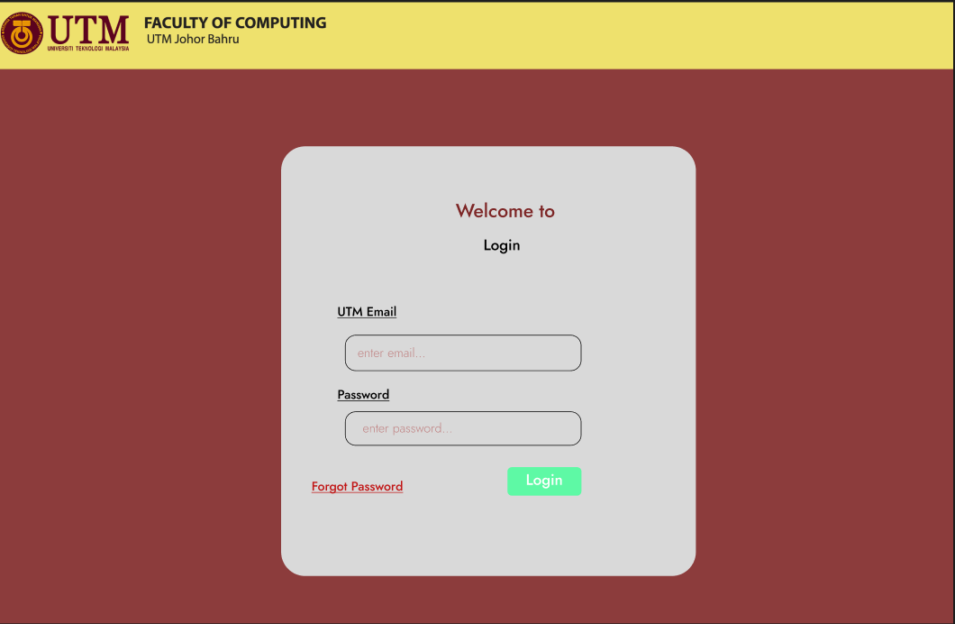
Authentication
Prototype

Slide 20
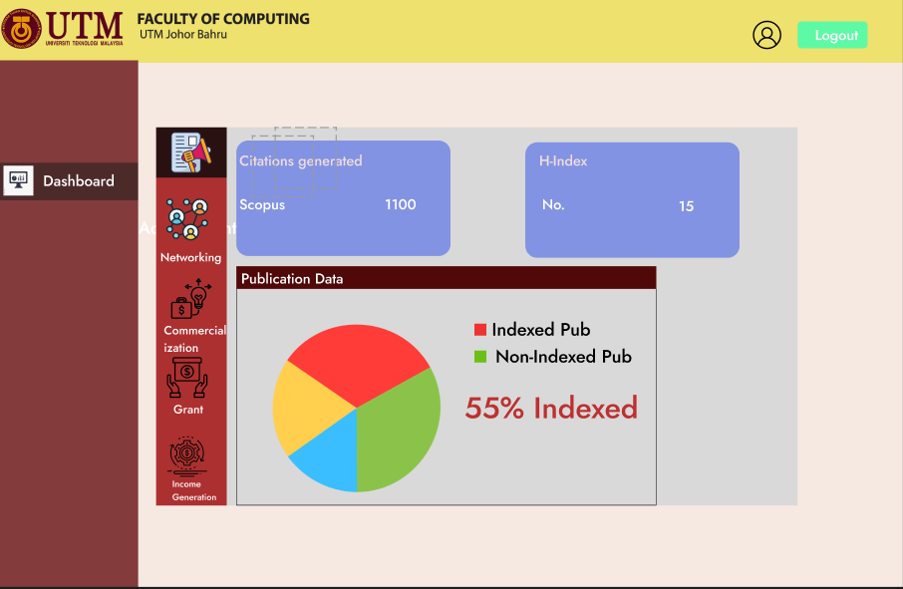
Prototype
Publication

Slide 21
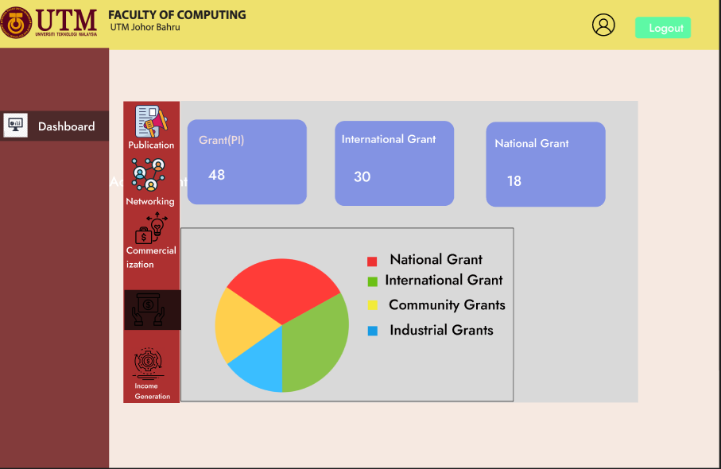
Prototype
Grant Page

Slide 22

Conclusion

